Slide 1
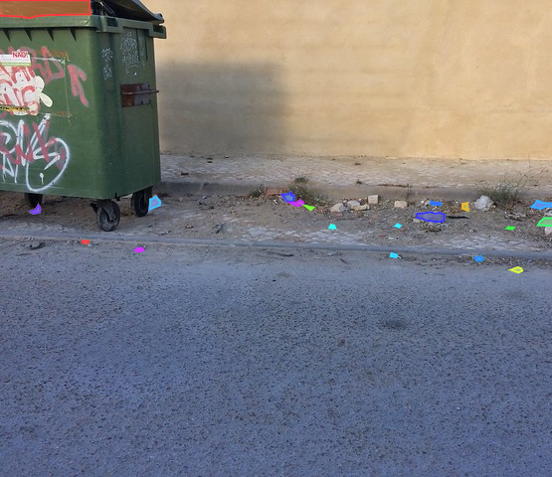
Searching for Litter with Computer Vision
Julian Hernandez
Mentor: Dr. Fitzgerald
California State University, Sacramento
27th Annual McNair Conference
June 2022

Slide 2
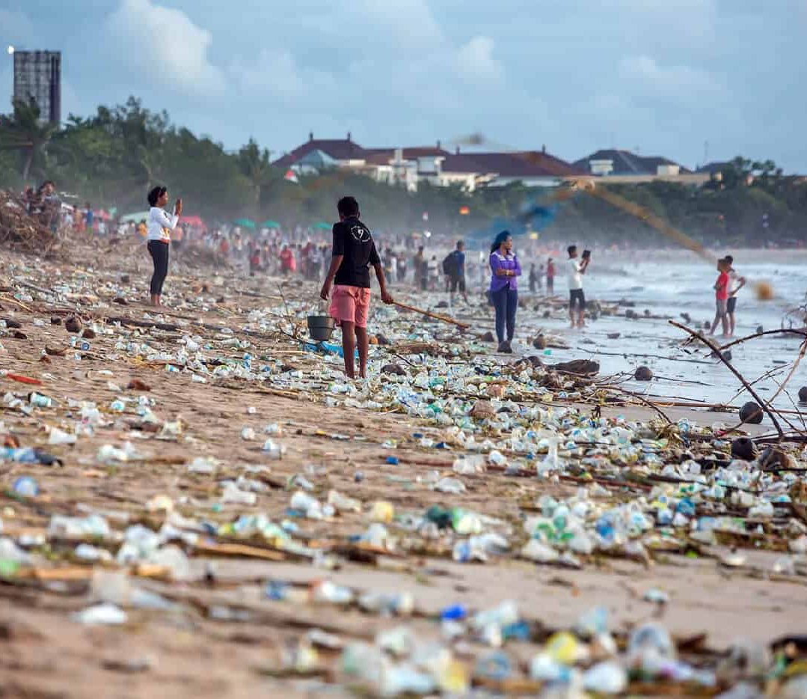
The Trash Problem
Can harm or kill animals
Contaminates of soil and ground water
Costs a lot of money to properly recycle
Releases green-house gas emissions

Slide 3
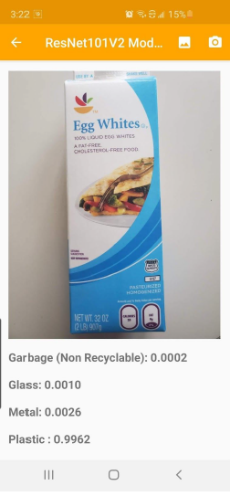
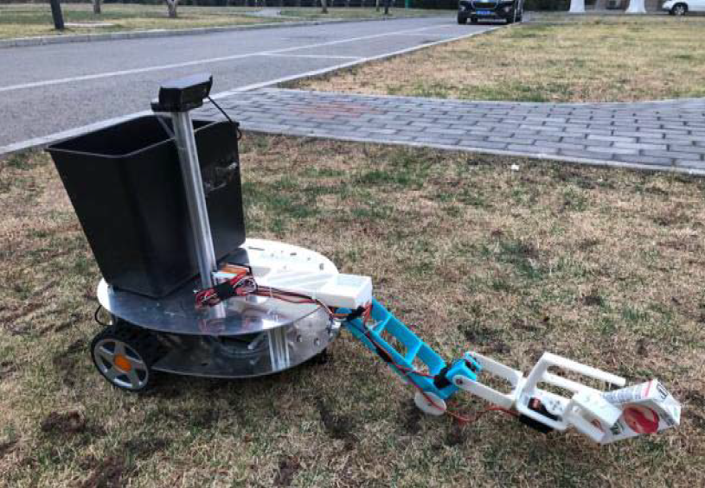
Previous Research
An android app uses computer vision to alert users the recyclability of a disposable carton
A trash cleanup robot designed to clean up parks and grassy areas reached 95% accuracy in detecting waste

Slide 4
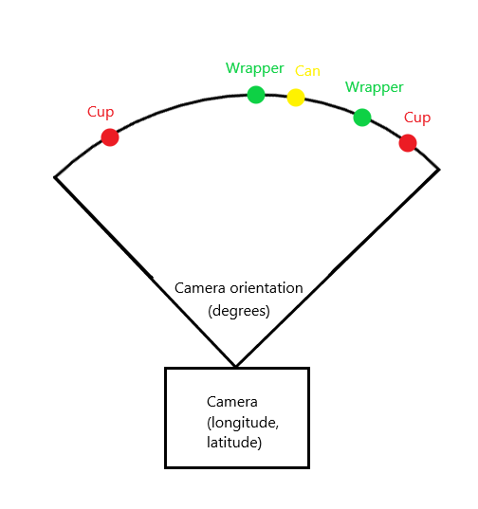
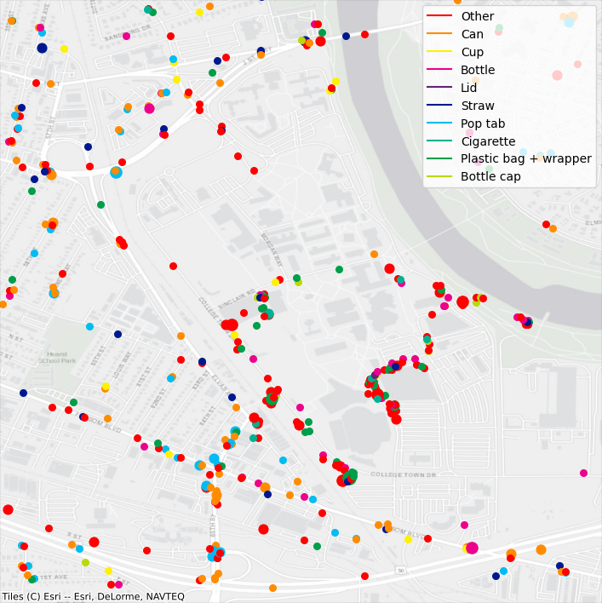
Goal of this Research
Where is litter located?
How much is there?

Slide 5
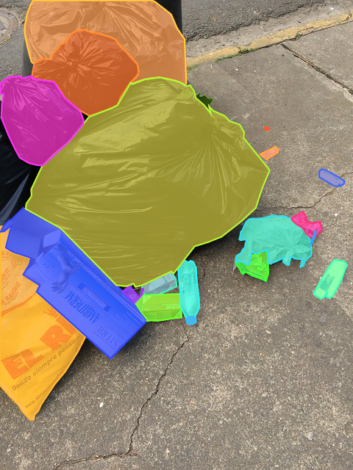
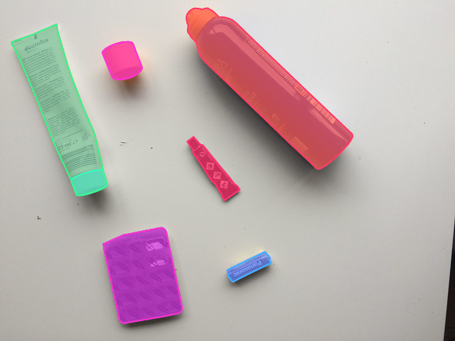
Trash Annotations in Context Dataset (TACO)
Photos and annotations can be added by the community

Slide 6
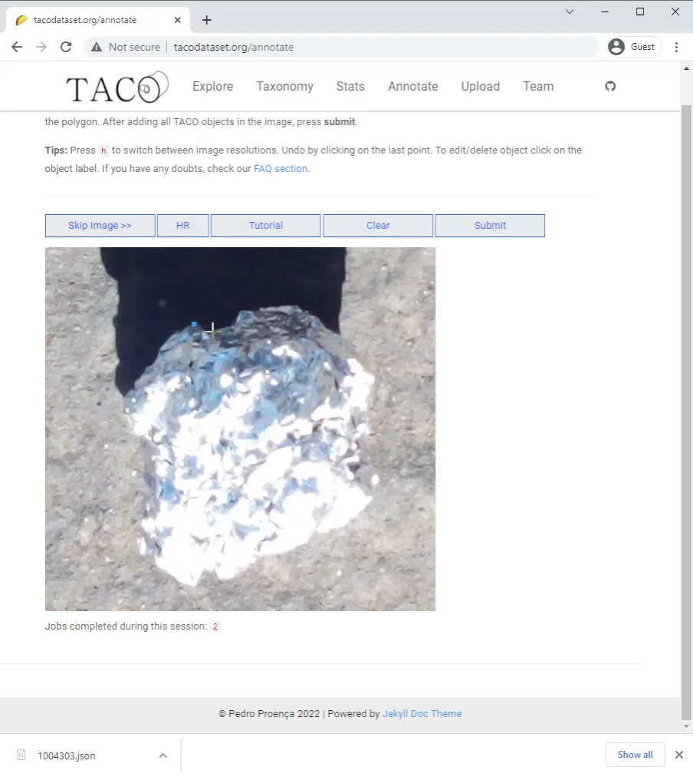
TACO Annotations
TACO is based on Common Objects in Context (COCO) but COCO is 200–400x larger
TACO:
1,500 images
4,700 outlined objects
COCO:
300,000 images
2,000,000 outlined objects

Slide 7
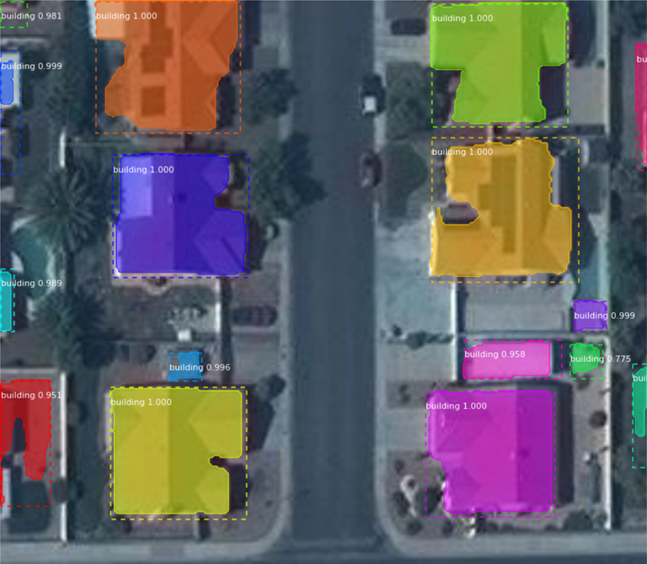
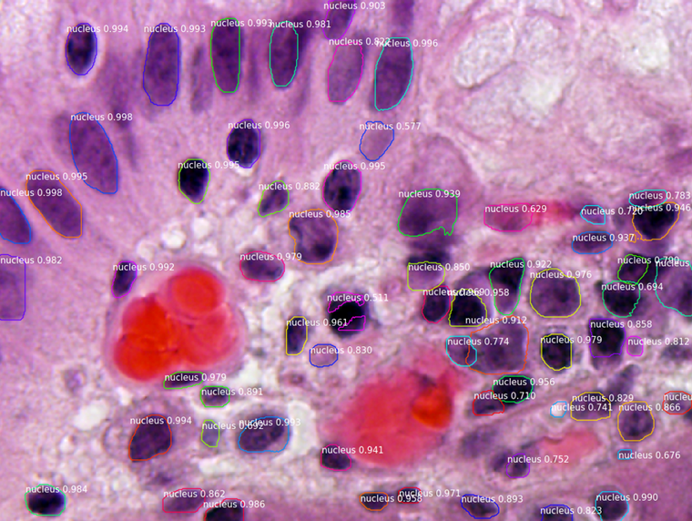
Mask Regional Convolutional Neural Network (Mask R-CNN)
Automatic building segmentation to aid humanitarian efforts
Nuclei detection for the 2018 Data Science Bowl Nuclei challenge

Slide 8
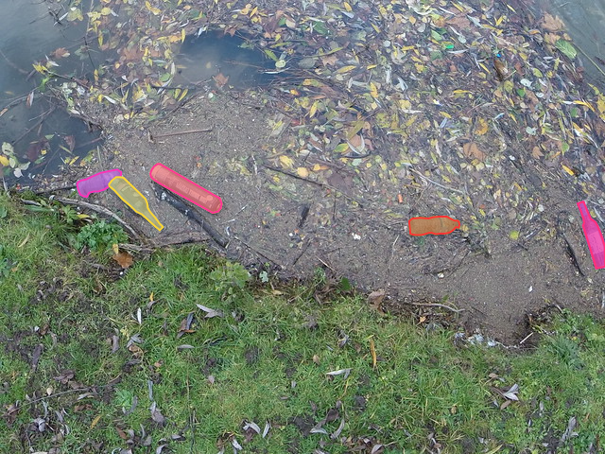
Feature Extraction

Slide 9
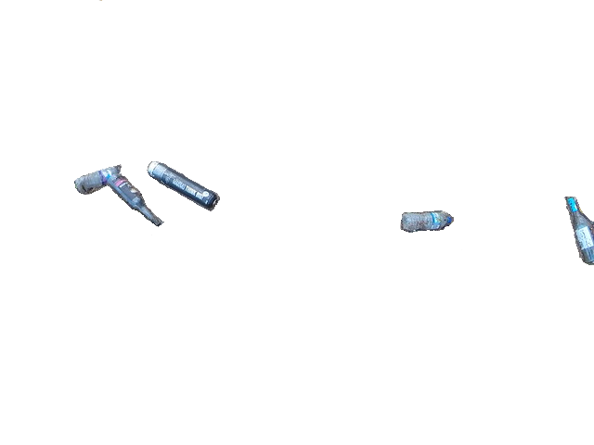
Feature Extraction

Slide 10
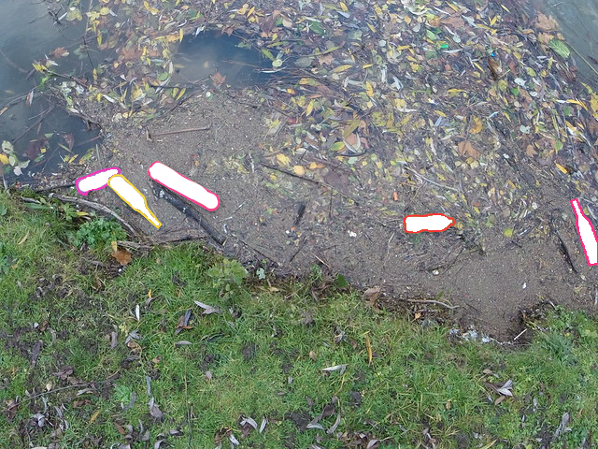
Feature Extraction

Slide 11
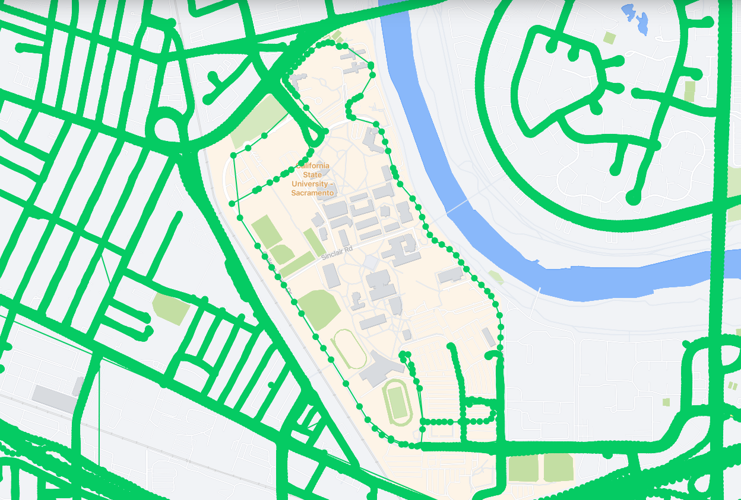
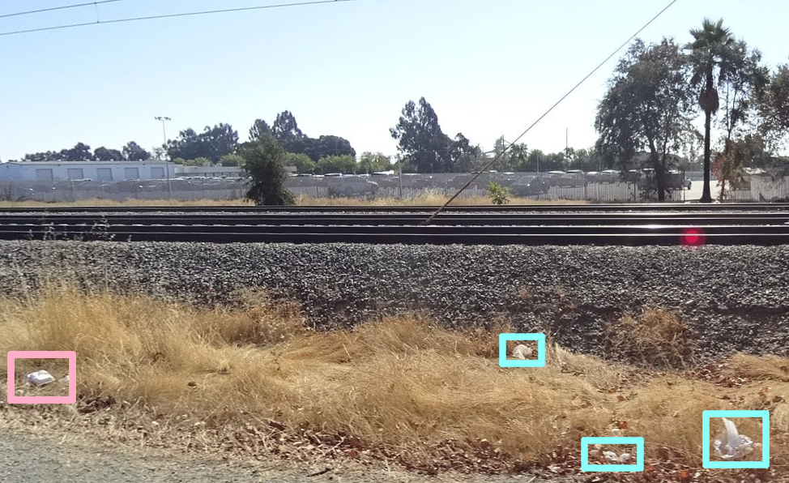
Street Level Images: Mapillary
Started in 2013
Spans 190 countries
Mapillary image cover around Sacramento State University
Sample Mapillary image with trash

Slide 12
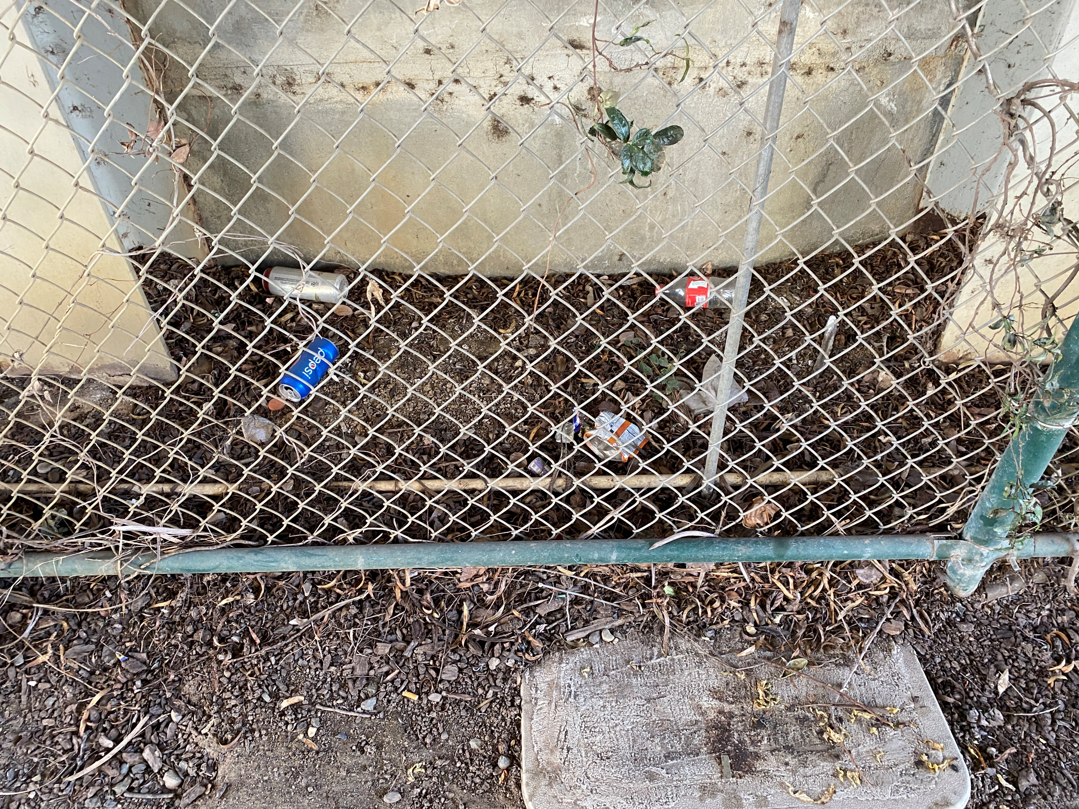
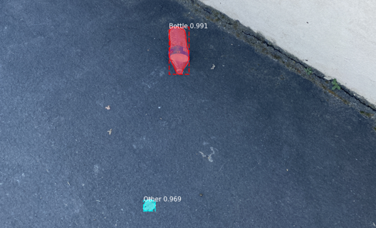
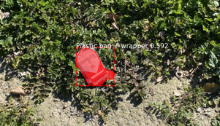
Cleanup Images
Can be taken on any smartphone or handheld device
Coordinates and other metadata are automatically added

Slide 13
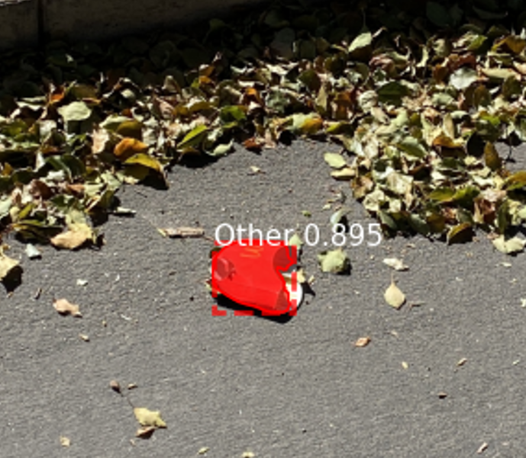
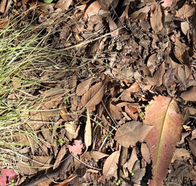
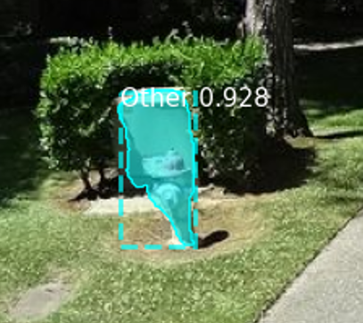
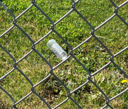
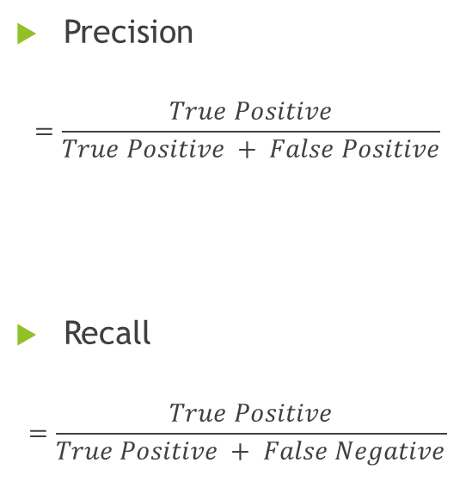
Metrics
 | Positive | Negative
True | True Positive (TP) | True Negative (TN)
False | False Positive (FP) | False Negative (FN)
Precision
$$=\frac{True Positive}{True Positive + False Positive}$$
Recall
$$=\frac{True Positive}{True Positive + False Negative}$$

Slide 14
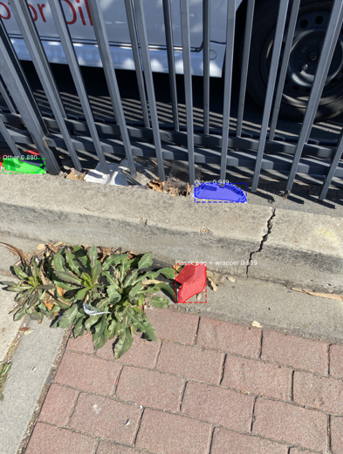
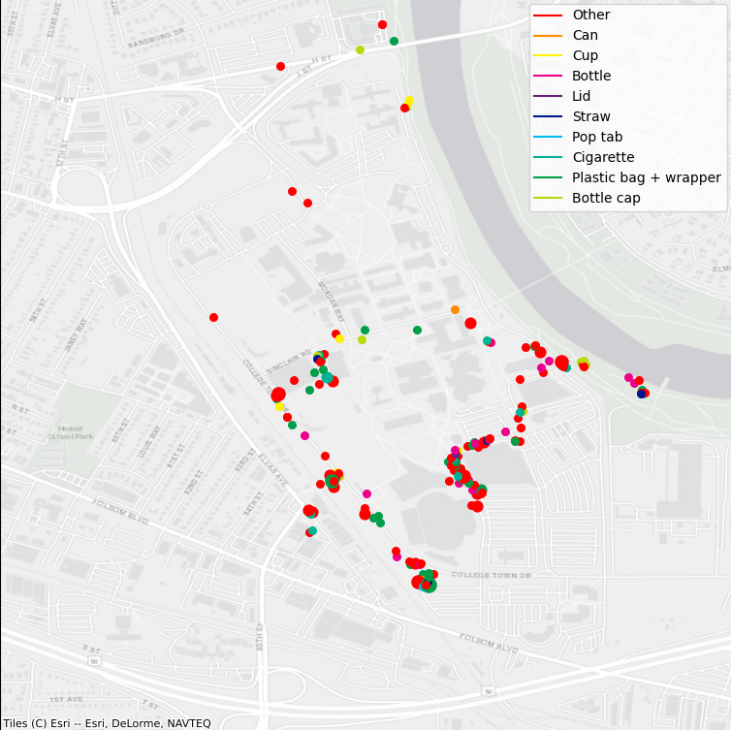
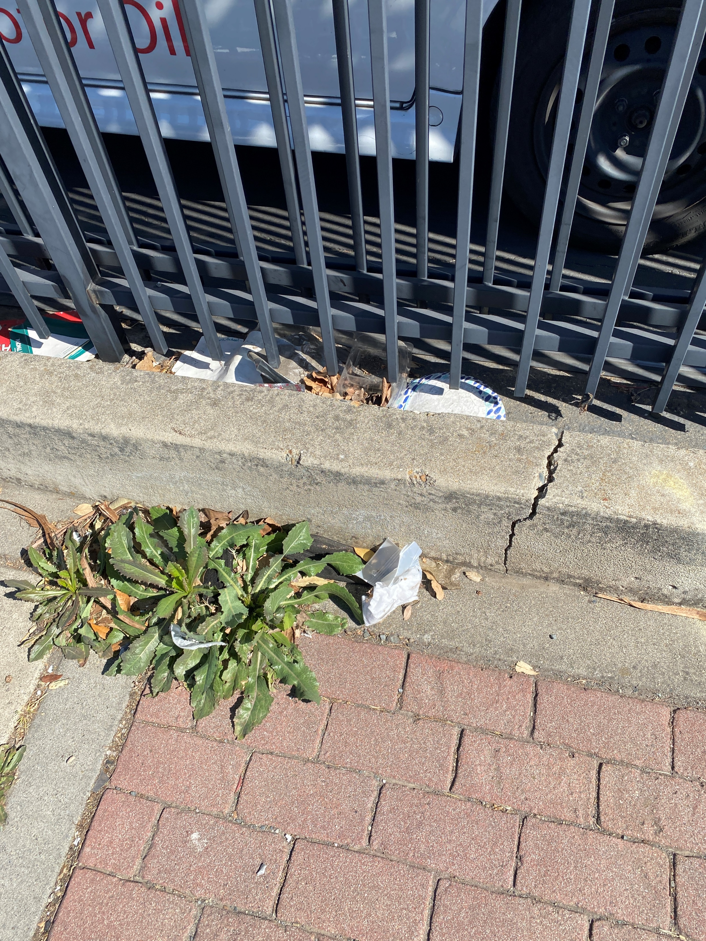
Results
Mapillary: precision = 1% and recall = 3%
River Cleanup: precision = 81% and recall = 74%

Slide 15
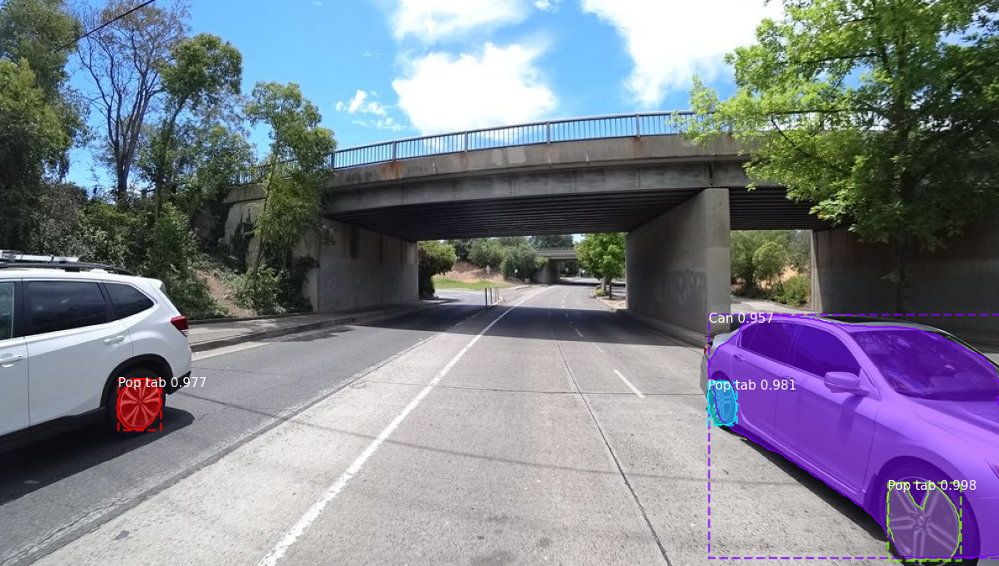
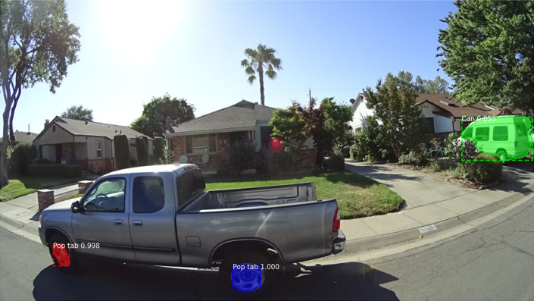
Misclassification
Common features: Texture, color, and shape
50% of false positives were from car mistakes alone

Slide 16
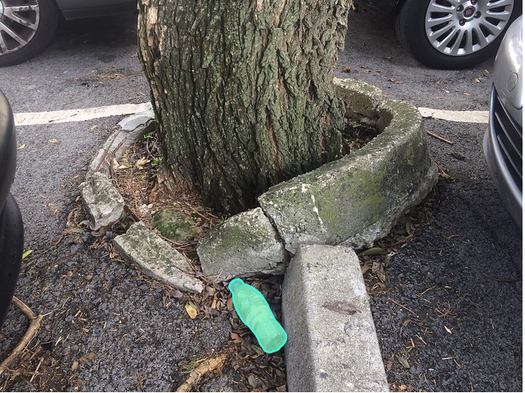
Future Work: New annotations
Use higher quality images
TACO needs new images with cars in the background and from new perspectives
Use distance for location calculations

Slide 17
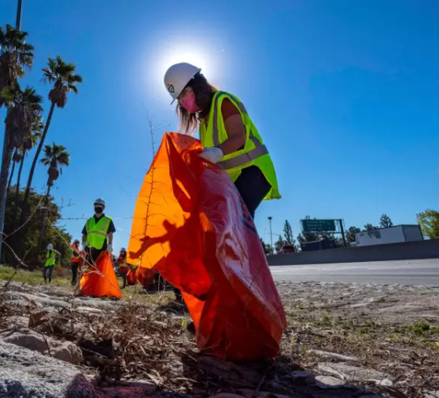
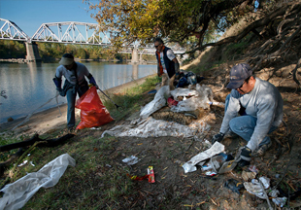
Conclusion
To use Mapillary to search for litter will require more annotations
Measuring waste management strategies using camera data is possible today
More images, annotations, and algorithm training will improve accuracy

Slide 18
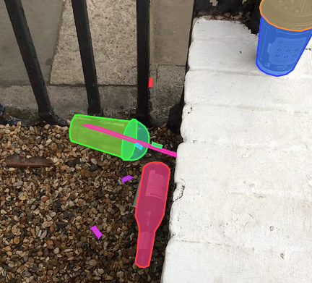
Questions?
Questions and comments can be directed to julianofhernandez@csus.edu

